Slide 1

M.Sc. AIML & Data Science
Semester – VIII
CC-416: PROJECT-III: Project
Group: | 4
Name & Roll No.: | Agarwal Shruti Hemant (DS-01) Sharma Radhika Shivkumar (DS-15)
Title: | Extractive and Abstractive Text Summarization: A Deep Learning & NLP Approach
Under the Guidance of Rashmi Pandey, Dr. Ravi Gor
Department of AIML & Data Science
School of Emerging Science & Technology
Gujarat University

Slide 2

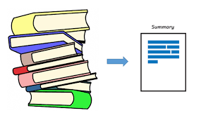

OUTLINE
 | Problem Statement
 | Objective
 | Introduction
 | Workflow
 | Methodology
 | Results & Conclusion
 | References & Future Work

Slide 3
PROBLEM STATEMENT
With more and more digitalized text being available, people are being overwhelmed with data.
This volume of text is an inestimable source of information and knowledge which needs to be effectively summarized to be useful.
Manually generating precise and fluent summaries of lengthy articles is a very tiresome and time-consuming task.

Slide 4

OBJECTIVE
To Eliminate manual efforts
To create a shorter version of a given text document.
To preserve the most important information contained in the original text.
To allow readers to quickly grasp the main ideas of a document without having to read through the entire text.
Notes:
The objectives of text summarization can vary depending on the specific use case, but some common objectives are:
Reducing the length of the text: This is the most common objective of text summarization, as it enables people to quickly understand the key information contained in a large document or article.
Improving readability and comprehensibility: Text summarization can help to improve the readability and comprehensibility of the text by presenting the most important information in a concise and easy-to-understand format.
Providing an overview of the text: Text summarization can provide an overview of the text, highlighting the main themes and ideas, and enabling people to get a sense of the overall content without having to read the entire document.
Supporting information retrieval and analysis: Text summarization can be used to support information retrieval and analysis by allowing users to quickly identify the most relevant information in a large corpus of documents.
Facilitating knowledge discovery: Text summarization can facilitate knowledge discovery by extracting the most important information from a large corpus of text, allowing users to identify patterns, relationships, and insights that might not be immediately apparent from reading the raw text.
Improving efficiency: By reducing the amount of text that needs to be read, text summarization can help to improve efficiency, enabling users to get more done in less time.
Improving accessibility: Text summarization can make information more accessible by providing a concise and easy-to-understand summary of complex or technical documents, making the information more accessible to people with different backgrounds and expertise levels.

Slide 5
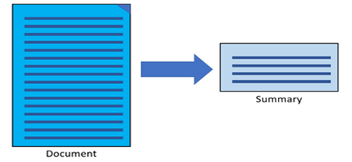
INTRODUCTION
The process of producing summaries from the huge sets of information while maintaining the actual context of information is called Text Summarization.

Slide 6



Some Popular Use Cases:
Notes:
The objectives of text summarization can vary depending on the specific use case, but some common objectives are:
Reducing the length of the text: This is the most common objective of text summarization, as it enables people to quickly understand the key information contained in a large document or article.
Improving readability and comprehensibility: Text summarization can help to improve the readability and comprehensibility of the text by presenting the most important information in a concise and easy-to-understand format.
Providing an overview of the text: Text summarization can provide an overview of the text, highlighting the main themes and ideas, and enabling people to get a sense of the overall content without having to read the entire document.
Supporting information retrieval and analysis: Text summarization can be used to support information retrieval and analysis by allowing users to quickly identify the most relevant information in a large corpus of documents.
Facilitating knowledge discovery: Text summarization can facilitate knowledge discovery by extracting the most important information from a large corpus of text, allowing users to identify patterns, relationships, and insights that might not be immediately apparent from reading the raw text.
Improving efficiency: By reducing the amount of text that needs to be read, text summarization can help to improve efficiency, enabling users to get more done in less time.
Improving accessibility: Text summarization can make information more accessible by providing a concise and easy-to-understand summary of complex or technical documents, making the information more accessible to people with different backgrounds and expertise levels.

Slide 7
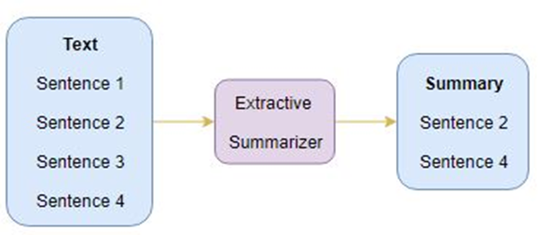
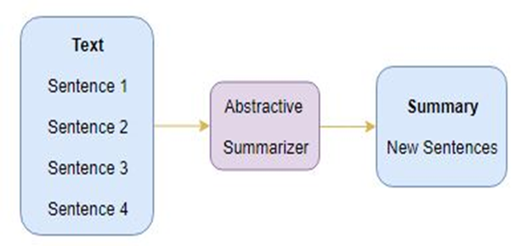
Types of Text Summarization
Extractive
Summarization
Abstractive
Summarization

Slide 8

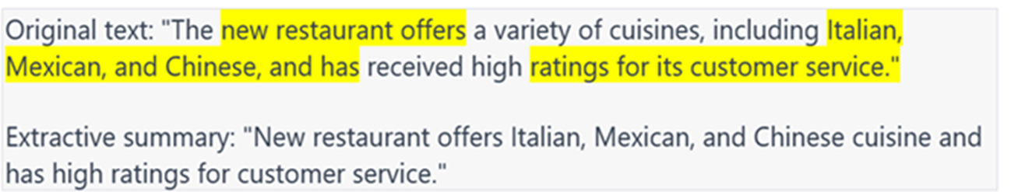


Extractive Summarization
Abstractive Summarization

Slide 9
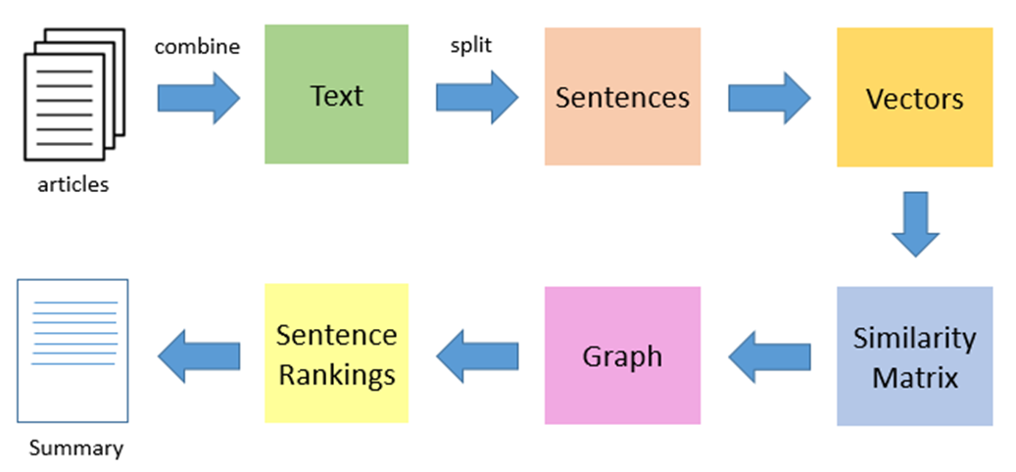
EXTRACTIVE WORKFLOW
Notes:
• The first step would be to concatenate all the text contained in the articles
• Then split the text into individual sentences
• In the next step, we will find vector representation (word embedding) for each and every sentence
• Similarities between sentence vectors are then calculated and stored in a matrix
• The similarity matrix is then converted into a graph, with sentences as vertices and similarity scores as edges, for sentence rank calculation
• Finally, a certain number of top-ranked sentences form the final summary

Slide 10
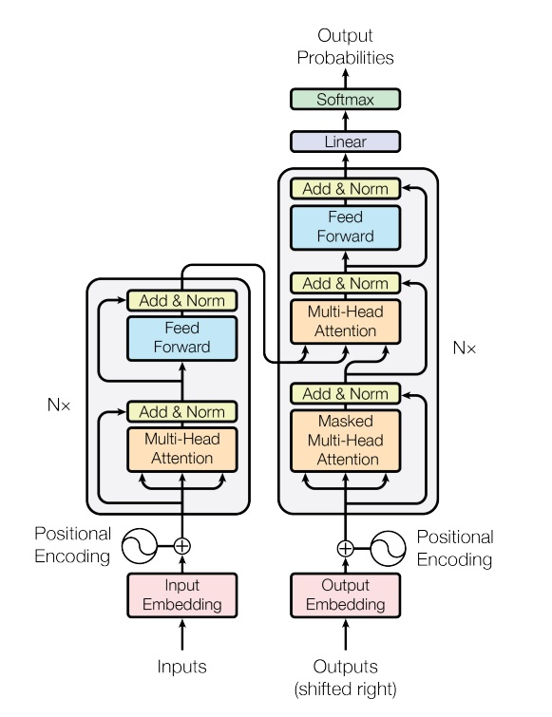
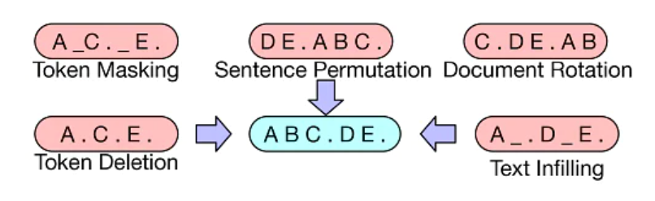
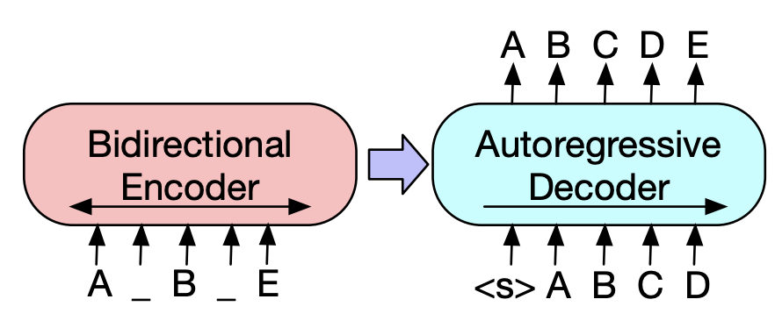
ABSTRACTIVE WORKFLOW
Notes:
• The first step would be to concatenate all the text contained in the articles
• Then split the text into individual sentences
• In the next step, we will find vector representation (word embedding) for each and every sentence
• Similarities between sentence vectors are then calculated and stored in a matrix
• The similarity matrix is then converted into a graph, with sentences as vertices and similarity scores as edges, for sentence rank calculation
• Finally, a certain number of top-ranked sentences form the final summary

Slide 11







METHODOLOGY
Libraries Used:
Notes:
TextRank:
Textrank is a graph-based ranking algorithm like Google’s PageRank algorithm which has been successfully implemented in citation analysis. We use text rank often for keyword extraction, automated text summarization and phrase ranking.
PageRank:
PageRank is a link analysis algorithm and it assigns a numerical weighting to each element of a hyperlinked set of documents, such as the World Wide Web, with the purpose of "measuring" its relative importance within the set. The algorithm may be applied to any collection of entities with reciprocal quotations and references.
LSA:
Latent Semantic Analysis is an robust Algebric-Statistical method which extracts hidden semantic structures of words and sentences i.e. it extracts the features that cannot be directly mentioned. These features are essential to data , but are not original features of the dataset. It is an unsupervised approach along with the usage of Natural Language Processing(NLP).
LexRank:
LexRank is an unsupervised approach to text summarization based on graph-based centrality scoring of sentences. The main idea is that sentences “recommend” other similar sentences to the reader. Thus, if one sentence is very similar to many others, it will likely be a sentence of great importance.
Luhn:
Luhn’s algorithm is an approach based on TF-IDF. It selects only the words of higher importance as per their frequency. Higher weights are assigned to the words present at the begining of the document.
Transformers T5:

Slide 12
METHODOLOGY
Data Preprocessing:
Lowercasing
Tokenization
Eliminate Punctuation
Eliminate Stop words and frequently occurring words
Stemming
Lemmatization
Notes:
TextRank:
Textrank is a graph-based ranking algorithm like Google’s PageRank algorithm which has been successfully implemented in citation analysis. We use text rank often for keyword extraction, automated text summarization and phrase ranking.
PageRank:
PageRank is a link analysis algorithm and it assigns a numerical weighting to each element of a hyperlinked set of documents, such as the World Wide Web, with the purpose of "measuring" its relative importance within the set. The algorithm may be applied to any collection of entities with reciprocal quotations and references.
LSA:
Latent Semantic Analysis is an robust Algebric-Statistical method which extracts hidden semantic structures of words and sentences i.e. it extracts the features that cannot be directly mentioned. These features are essential to data , but are not original features of the dataset. It is an unsupervised approach along with the usage of Natural Language Processing(NLP).
LexRank:
LexRank is an unsupervised approach to text summarization based on graph-based centrality scoring of sentences. The main idea is that sentences “recommend” other similar sentences to the reader. Thus, if one sentence is very similar to many others, it will likely be a sentence of great importance.
Luhn:
Luhn’s algorithm is an approach based on TF-IDF. It selects only the words of higher importance as per their frequency. Higher weights are assigned to the words present at the begining of the document.
Transformers T5:

Slide 13
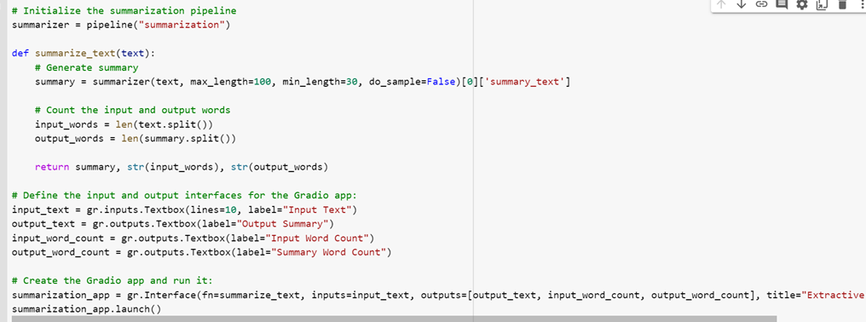
METHODOLOGY
GUI:
Extractive Summarizer Code
Notes:
TextRank:
Textrank is a graph-based ranking algorithm like Google’s PageRank algorithm which has been successfully implemented in citation analysis. We use text rank often for keyword extraction, automated text summarization and phrase ranking.
PageRank:
PageRank is a link analysis algorithm and it assigns a numerical weighting to each element of a hyperlinked set of documents, such as the World Wide Web, with the purpose of "measuring" its relative importance within the set. The algorithm may be applied to any collection of entities with reciprocal quotations and references.
LSA:
Latent Semantic Analysis is an robust Algebric-Statistical method which extracts hidden semantic structures of words and sentences i.e. it extracts the features that cannot be directly mentioned. These features are essential to data , but are not original features of the dataset. It is an unsupervised approach along with the usage of Natural Language Processing(NLP).
LexRank:
LexRank is an unsupervised approach to text summarization based on graph-based centrality scoring of sentences. The main idea is that sentences “recommend” other similar sentences to the reader. Thus, if one sentence is very similar to many others, it will likely be a sentence of great importance.
Luhn:
Luhn’s algorithm is an approach based on TF-IDF. It selects only the words of higher importance as per their frequency. Higher weights are assigned to the words present at the begining of the document.
Transformers T5:

Slide 14
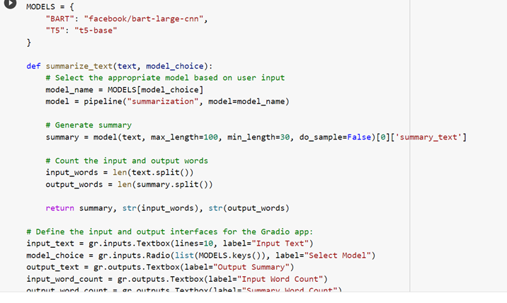
METHODOLOGY
GUI:
Abstractive Summarizer Code
Notes:
TextRank:
Textrank is a graph-based ranking algorithm like Google’s PageRank algorithm which has been successfully implemented in citation analysis. We use text rank often for keyword extraction, automated text summarization and phrase ranking.
PageRank:
PageRank is a link analysis algorithm and it assigns a numerical weighting to each element of a hyperlinked set of documents, such as the World Wide Web, with the purpose of "measuring" its relative importance within the set. The algorithm may be applied to any collection of entities with reciprocal quotations and references.
LSA:
Latent Semantic Analysis is an robust Algebric-Statistical method which extracts hidden semantic structures of words and sentences i.e. it extracts the features that cannot be directly mentioned. These features are essential to data , but are not original features of the dataset. It is an unsupervised approach along with the usage of Natural Language Processing(NLP).
LexRank:
LexRank is an unsupervised approach to text summarization based on graph-based centrality scoring of sentences. The main idea is that sentences “recommend” other similar sentences to the reader. Thus, if one sentence is very similar to many others, it will likely be a sentence of great importance.
Luhn:
Luhn’s algorithm is an approach based on TF-IDF. It selects only the words of higher importance as per their frequency. Higher weights are assigned to the words present at the begining of the document.
Transformers T5:

Slide 15

RESULTS
An automatic extractive and abstractive text summarization model which reads the text given as input by the user and perceive its content and results the necessary summed up text having just the central idea illustrated in the text in a compact way.

Slide 16
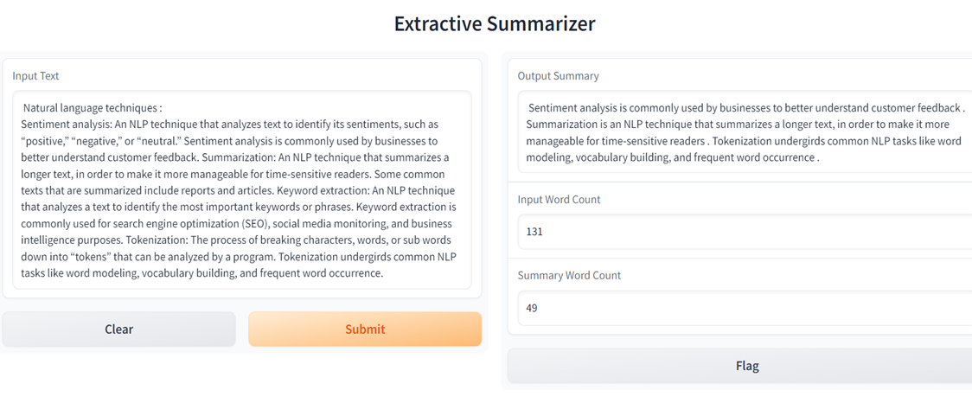
RESULTS: EXTRACTIVE SUMMARIZER

Slide 17
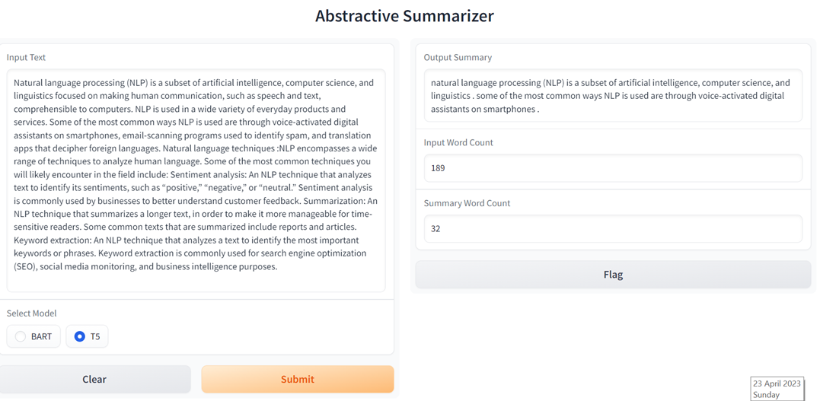
RESULTS: T5 ABSTRACTIVE SUMMARIZER

Slide 18
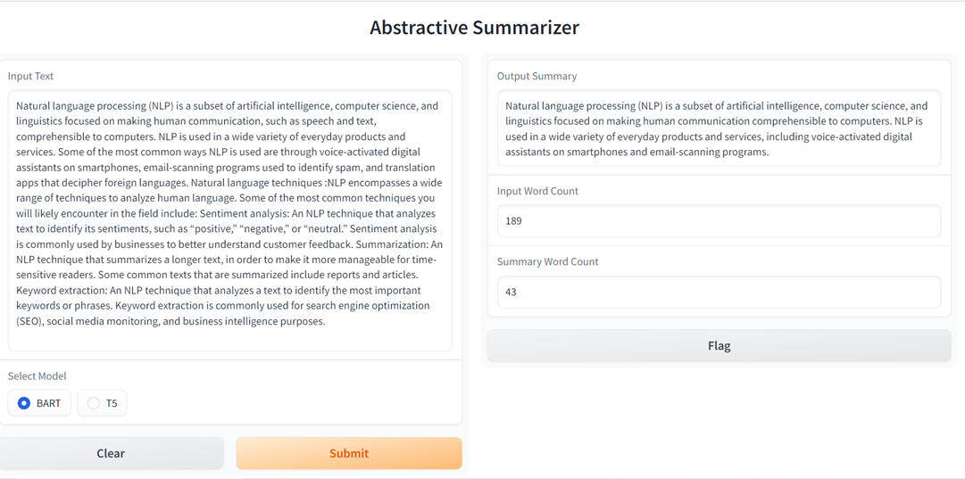
RESULTS: BART ABSTRACTIVE SUMMARIZER

Slide 19
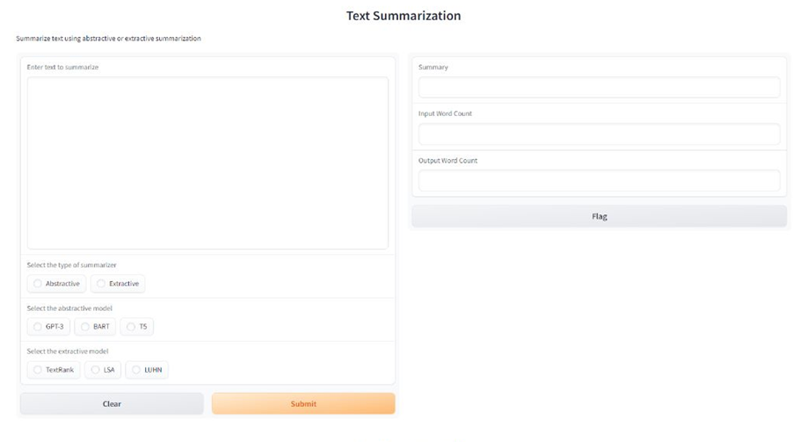
RESULTS: COMMON INTERFACE

Slide 20
REFERENCES
Abigail See, P. J. (2017). Get to the point: Summarization with point-generator networks.
Ashish Vaswani, N. S. (2017). Attention is all you need.
Chadrasekhar, G. (2020, August). Understanding Abstractive Text Summarization from Scratch. Retrieved from Towards AI: https://pub.towardsai.net/understanding-abstractive-text-summarization-from-scratch-baaf83d446b3
docs. (n.d.). Retrieved from gradio: https://gradio.app/docs/
Dongdong Zhang, G. L. (2020). Unified Language Model Pre-training for Natural Language Understanding and Generation.
Duseja, S. (2020, August). Text Summarization Using Deep Neural Networks. Retrieved from Towards Data Science: https://towardsdatascience.com/text-summarization-using-deep-neural-networks-e7ee7521d804
Gradio Docs. (n.d.). Retrieved from gradio: https://gradio.app/docs/
Joshi, P. (2018, February). An Introduction to Text Summarization using the TextRank Algorithm. Retrieved from Analytics Vidhya: https://www.analyticsvidhya.com/blog/2018/11/introduction-text-summarization-textrank-python/
Jwalapuram, N. (2021, August). An Introduction to Natural Language Processing with Transformers. Retrieved from Analytics Vidhya: https://www.analyticsvidhya.com/blog/2021/08/an-introduction-to-natural-language-processing-with-transformers/
Lapata, Y. L. (2019). Fine-tune BERT for Extractive Summarization.
NLP-Course. (n.d.). Retrieved from Hugging Face: https://huggingface.co/learn/nlp-course/chapter1/2?fw=pt
Pai, A. (2019, June). Comprehensive Guide to Text Summarization using Deep Learning in Python. Retrieved from Analytics Vidhya: https://www.analyticsvidhya.com/blog/2019/06/comprehensive-guide-text-summarization-using-deep-learning-python/
Ramesh Nallapati, F. Z. (2016). Abstractive Text Summarization using Sequence-to-sequence RNNs and Beyond.
Tarau, R. M. (2004). TextRank: Bringing Order into Texts .
Transformers Docs. (n.d.). Retrieved from Hugging Face: https://huggingface.co/transformers/v3.0.2/index.html

Slide 21
FUTURE WORK
Improving the quality of summaries
Multi-document summarization
Summarization for different domains
Extractive and abstractive summarization
Notes:
• The first step would be to concatenate all the text contained in the articles
• Then split the text into individual sentences
• In the next step, we will find vector representation (word embedding) for each and every sentence
• Similarities between sentence vectors are then calculated and stored in a matrix
• The similarity matrix is then converted into a graph, with sentences as vertices and similarity scores as edges, for sentence rank calculation
• Finally, a certain number of top-ranked sentences form the final summary

Slide 22
ANY QUESTIONS?

Slide 23
THANK YOU

